Slide 1
Python Strings

Slide 2
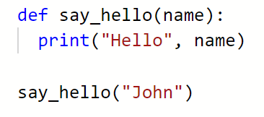
But first a reminder - functions
Function name
Parameters
Function body

Slide 3

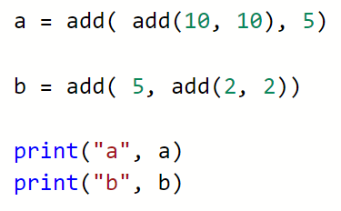
What will this output?

Slide 4


Slide 5
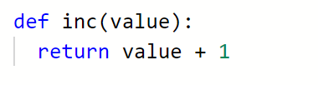
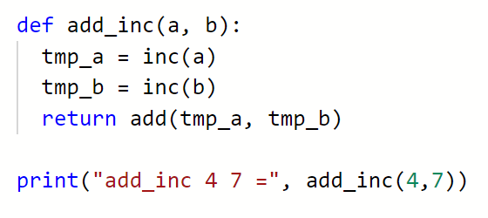
Calling functions from
within functions

Slide 6

Calling functions from
within functions

Slide 7
Today -- strings
We have looked at lists
[]
Sequence types – they behave like sequences
String is also a sequence type

Slide 8
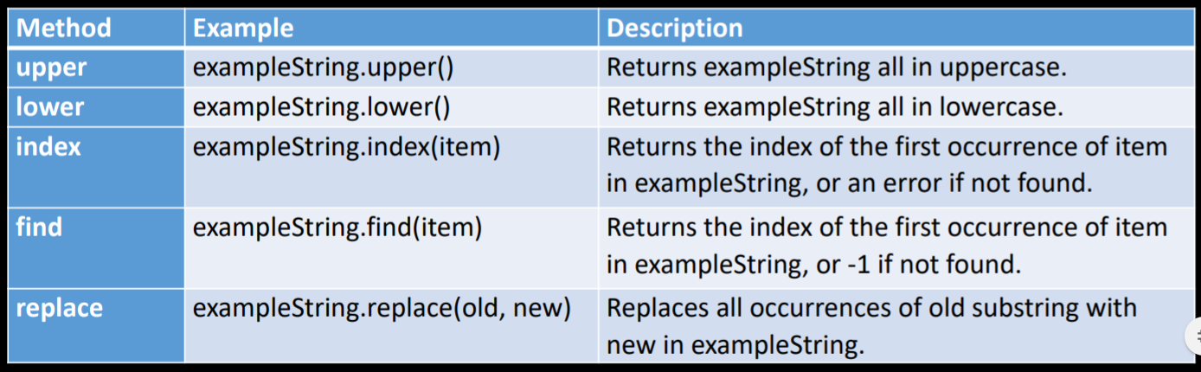
String Methods
A string in Python is an object
The string object has methods that perform useful tasks

Slide 9
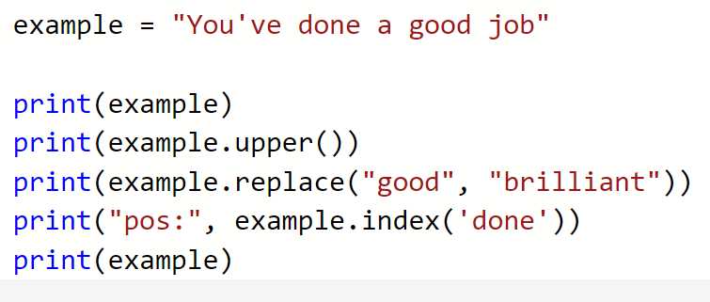
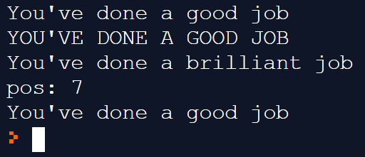

Slide 10


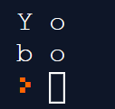
Like lists the ‘elements’ (characters) have indexes

Slide 11
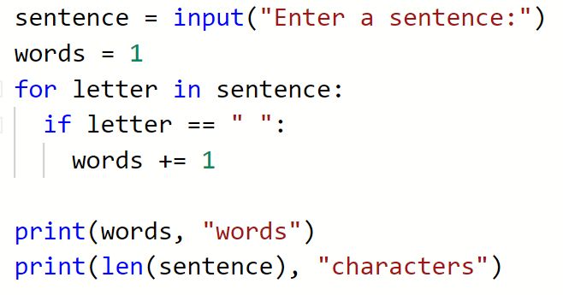
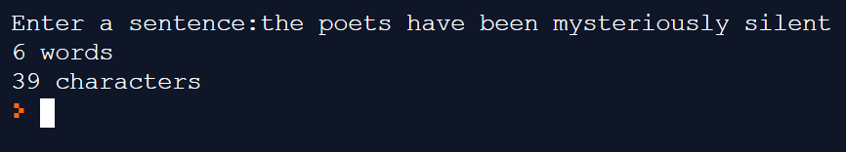

Slide 12
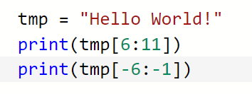
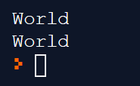
slices
Using indexes you can isolate a single character in a string
Using slicing you can isolate anything from a single character to a whole string

Slide 13
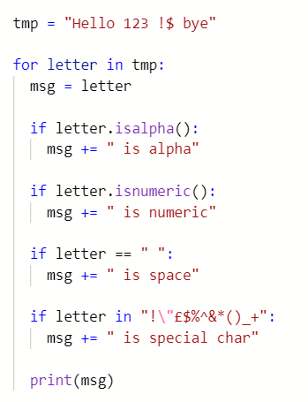
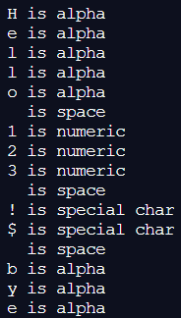

Slide 14
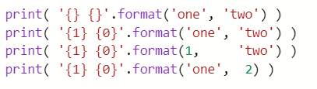


Slide 15
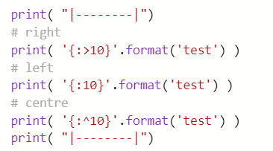
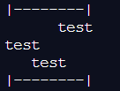

Slide 16
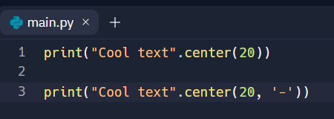
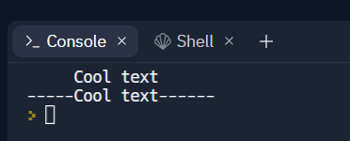

Slide 17


Slide 18
Activities
There is an worksheet on Sharepoint to practice looping and string operations
We will review the code at the start of the next lecture
Make sure you keep practicing you Python coding in between lectures
Make sure you complete all the activity sheets I give to you

